Slide 1
Content / Guide slide
Section 1: Company Overview
  Megatrends as backdrop
  Who is twoday
  Mission/Purpose/Values
  Presence & People
  Leadership Team
Section 2: Slides for internal use
  Owner: CVC
  Employee Incentive Program
  Employee engagement driving growth
Section 3: Key Facts & Figures
  Year founded, # of employees, # of countries, revenue
  Key industries served
  Certifications, major partnerships
Section 4: Services Overview
  Industries
  Technology Domains
Section 5: Our Value Proposition
  Why clients choose us
  Case studies – success stories
Section 6: Contact information
  Template slide for people to fill in their own contact details
  Link to website

Slide 2
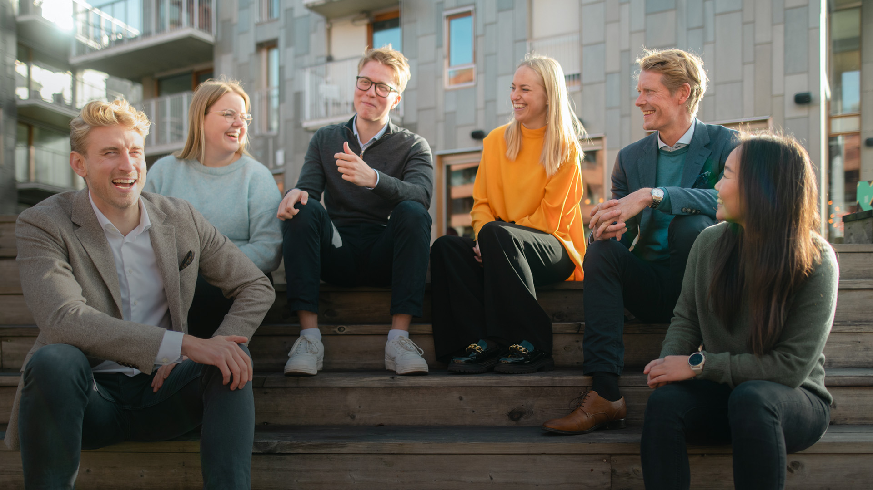
We create a better tomorrow through technology

Slide 3
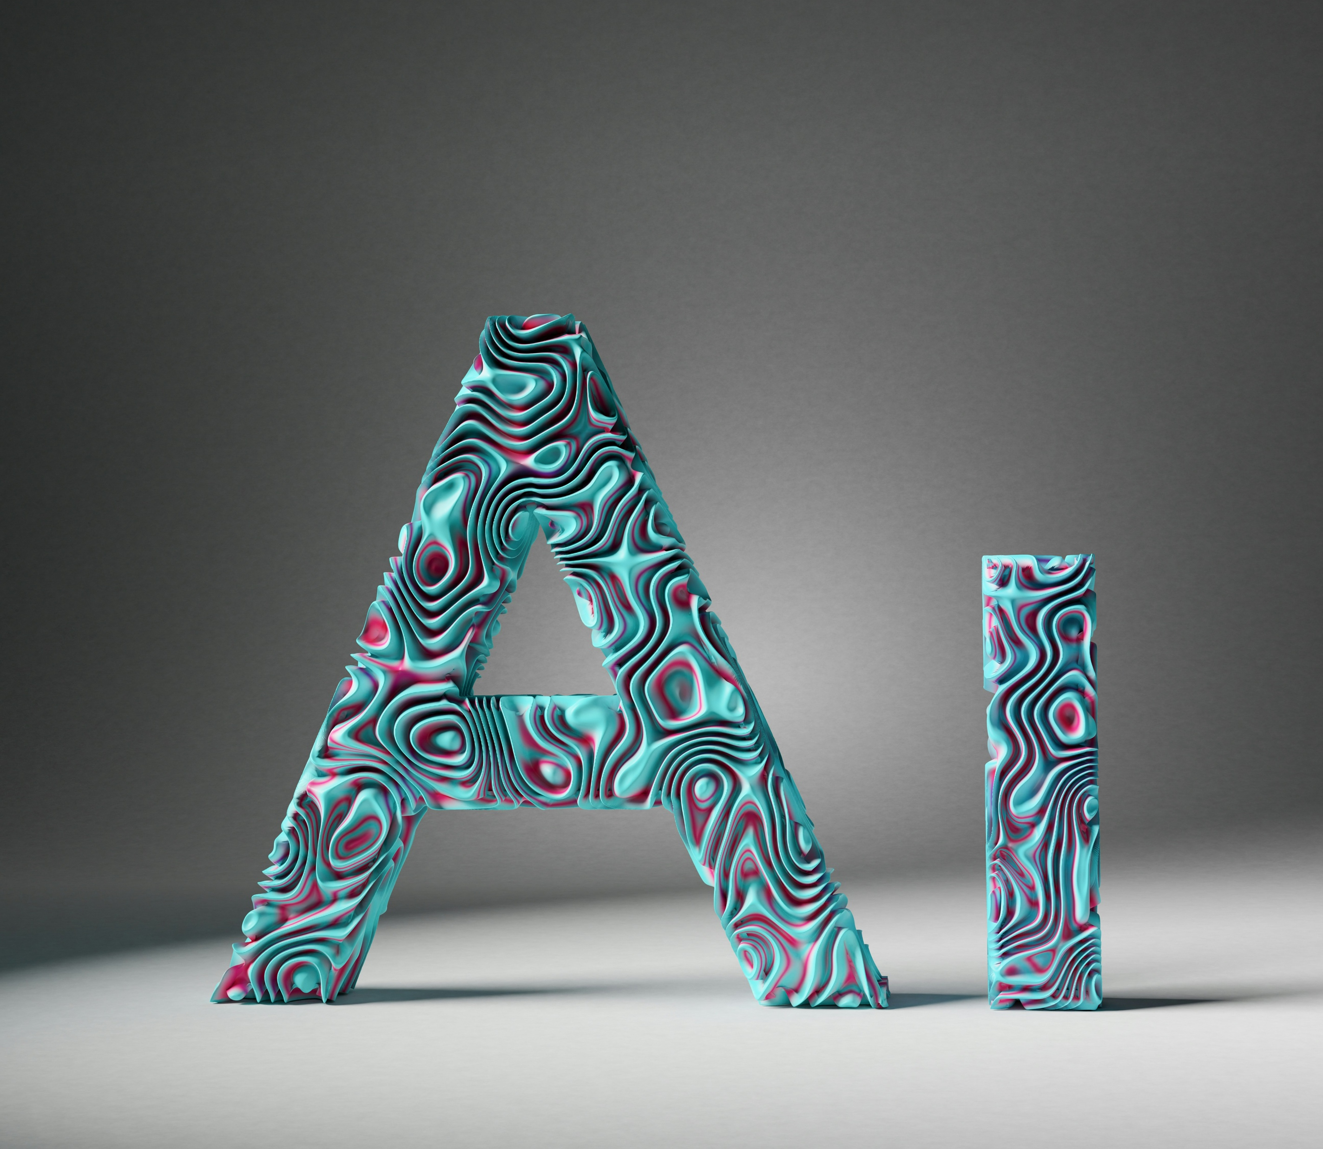




Megatrends are transforming our market and shaping demands
The rise of AI
Green transition
Ageing population
Digital-first world
Geopolitical shifts
72% of business leaders see AI as central to their business by 2025
New regulations are driving companies to use digital engineering for environmental compliance
By 2050, 1 in 6 people will be aged 65+, challenging governments to rethink healthcare, social care, and public services
Consumers expect seamless digital experiences, with 79%
of organizations citing cybersecurity as a top priority
Global power dynamics are changing, requiring Europe to invest in defense and security, driven by AI and data technologies
Notes:
The Rise of AI
AI is no longer a distant future—it's shaping industries today.
A staggering 72% of business leaders see AI as central to their strategy by 2025.
Companies that successfully integrate AI will gain a competitive edge, enhancing efficiency, decision-making, and customer experiences.
The challenge isn’t just adopting AI but doing so responsibly, ensuring transparency, security, and ethical use.
Green Transition
Sustainability is no longer optional—it's a business imperative.
Governments, investors, and consumers are pushing for greener solutions, creating both challenges and opportunities.
Technology, including AI and data-driven insights, plays a critical role in optimizing energy use, reducing emissions, and enabling circular economies.
Businesses that embrace the green transition will future-proof their operations and gain trust in an increasingly eco-conscious market.
Ageing Population
By 2050, 1 in 6 people globally will be aged 65 or older—a demographic shift with major societal and economic implications.
Governments must rethink healthcare, social care, and public services to support an ageing population.
Technology, including AI and data-driven healthcare solutions, will play a critical role in improving elderly care, predicting health trends, and optimizing resources.
Businesses will also need to adapt—whether through age-inclusive workforce policies or products and services tailored to older consumers.
Digital-First World
Digital is now the default—consumers expect seamless, fast, and secure digital experiences.
Organizations are responding, with 79% citing cybersecurity as a top priority.
The rise of AI, cloud computing, and automation brings opportunities—but also greater cyber risks.
Businesses must invest in robust cybersecurity, data privacy, and resilience to maintain trust in an increasingly digital landscape.
Geopolitical Shifts
Global power dynamics are evolving, creating new challenges for governments and businesses alike.
Europe is increasingly investing in defense and security, with AI and data technologies playing a key role.
Cybersecurity, supply chain resilience, and digital sovereignty are becoming strategic priorities in an unpredictable world.
Organizations must navigate these shifts by staying agile, investing in technology, and ensuring compliance with evolving regulations.

Slide 4

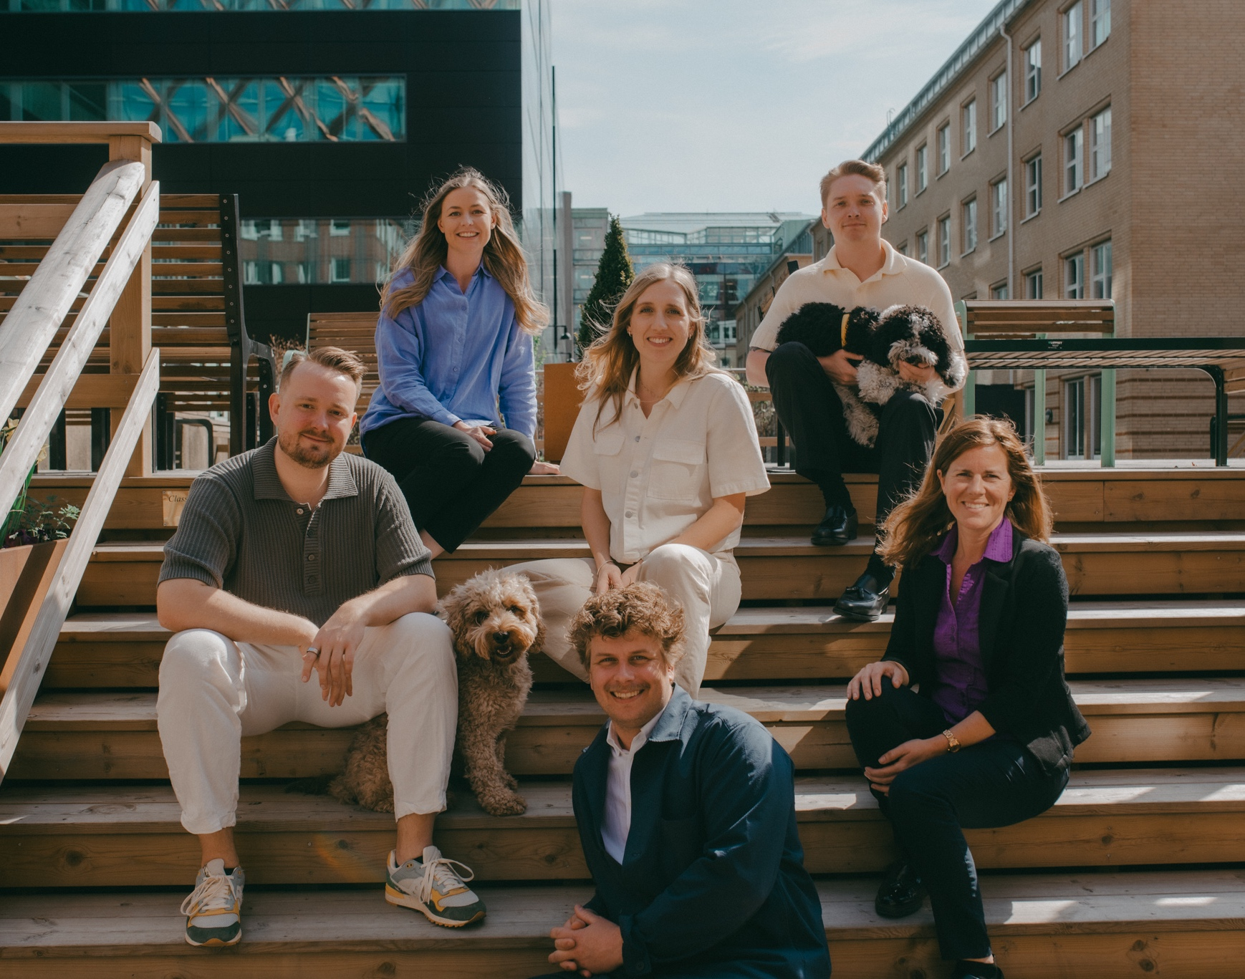



Stronger together
Our core values guide us to create better solutions for you
Heart
Drive
Adaptability
Notes:
Heart
Our business is run with heart.
We care about people, our customers and society. We are a warm community filled with people that have fun and laugh together.
We welcome people as they are, we team up and thrive together.
Drive
To succeed in the digital transformation of our society we need people with initiative, dedication and engagement.
People that continuously develop themselves and learn new things is the key to deliver the competence that is needed in the digital age.
Our drive and ambition moves society forward.
Adaptability
Technology is constantly changing and so are the needs of people and organizations.
We are adaptable in our approach, down to earth and easy to work with.
We trust in people and believe that we do our best with a good balance of freedom and responsibility.

Slide 5

Who is twoday?
We create a better tomorrow through technology, delivering IT solutions that drive transformation across key industries.
As one of the largest technology consulting firms in the Nordics, we combine deep industry expertise with ambitious innovation to set new benchmarks.
Our people — experts in technology, strategy, and innovation — solve complex challenges, helping businesses not just adapt but lead.
By understanding today’s business challenges, we develop solutions that drive measurable impact and long-term growth.
The future belongs to those who innovate and embrace change—we are here to make it happen.
Notes:
We create a better tomorrow through technology. As
one of the largest technology consulting companies
in the Nordics, we combine deep industry expertise
with ambitious innovation to deliver IT solutions that
drive transformation. Across key verticals, we have
developed market-leading solutions that set new
industry benchmarks and empower businesses to
stay ahead in an ever-evolving digital landscape.
At the heart of our company is a commitment to
people. The brightest minds in technology, strategy,
and innovation work with dedication and drive to
solve complex challenges and create real business
impact. With deep technical expertise and a sharp
understanding of industry needs, our teams design
solutions that help businesses not only adapt
but lead. Their talent, determination, and ability
to embrace change ensure that we remain at the
forefront of our industry.
By understanding the challenges businesses face
today, we develop solutions that drive measurable
impact and long-term growth. We strive to be the
preferred IT solutions provider, partnering with
organisations that seek not just to adapt but to lead.
The future belongs to those who innovate, and we
are here to make it happen. The future is shaped
by those who embrace change, and we are here to
make it happen.

Slide 6
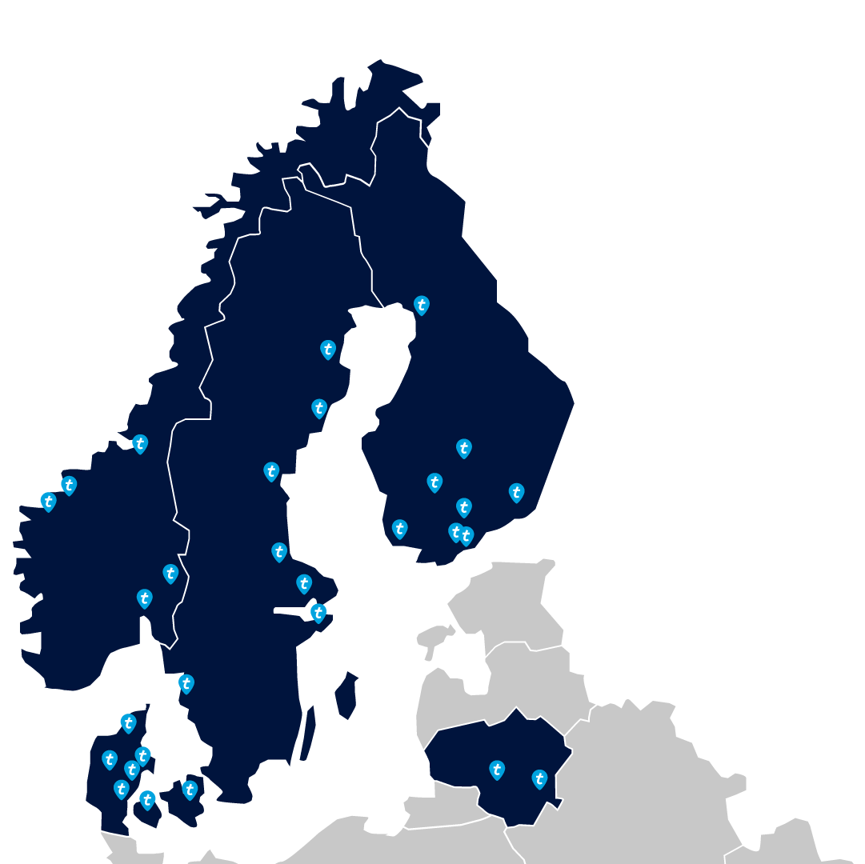
Presence and people
twoday office
Local Presence
With teams across five countries, twoday is deeply embedded in local business environments, enabling industry-specific insights, faster response times, and stronger collaboration to deliver impactful solutions.
People First
twoday prioritizes talent retention and growth, maintaining a low voluntary attrition rate. By fostering engagement and professional development, twoday remains an attractive, forward-thinking workplace.
Notes:
Local Presence
twoday is built on a strong local presence and a commitment to its 2600
people. Being present in multiple cities across five operating countries
ensures that the teams in twoday are embedded in the local business
environments of our customers. This local presence enables a deeper
understanding of industry-specific challenges, faster response
times, and stronger collaboration both internally and with customers,
ensuring that twoday can deliver solutions that are both relevant and
impactful.
Workspaces in Focus
At the same time, twoday is dedicated to fostering a high-quality
working environment for our employees. In 2024, twoday made
significant investments in upgrading and relocating to new office
facilities across several locations, ensuring modern and collaborative
workspaces that support both productivity and well-being. In selected
cities, offices were consolidated to strengthen internal collaboration
and create a greater sense of community among employees.
People First
twoday is also strongly committed to retaining and developing talent,
as reflected in a low voluntary attrition rate compared to industry
standards. In a fast-moving industry, the ability to grow with and
through our people is a key driver of sustained value creation. Building
strong internal capabilities, encouraging engagement, and supporting
professional growth help ensure that twoday remains an attractive
and forward-looking workplace. This commitment is evident in our low
voluntary attrition rate, which remains below industry norms.

Slide 7
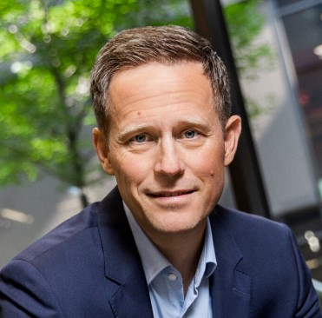

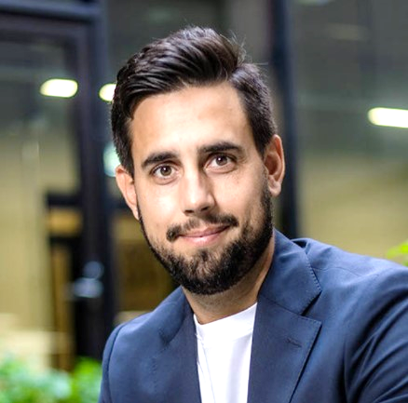


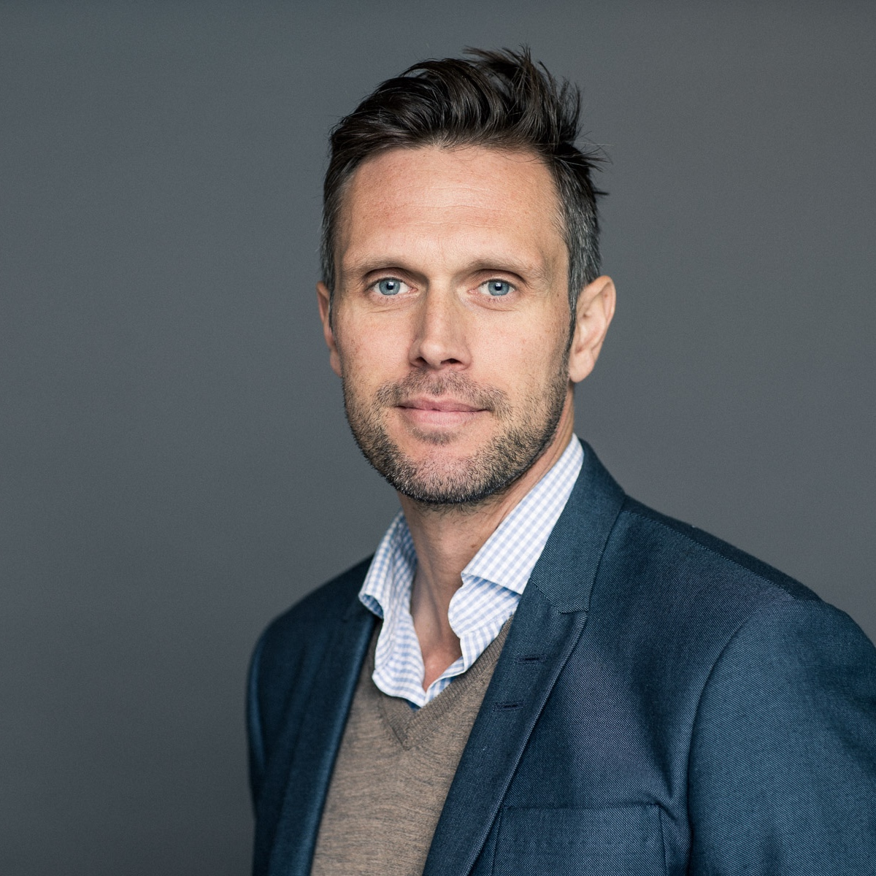


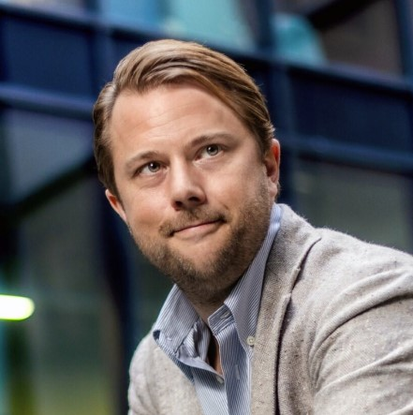
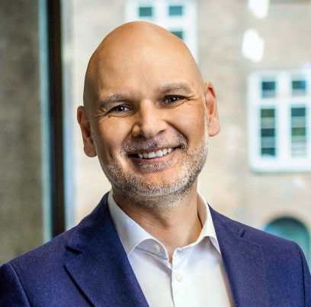
twoday Executive Leadership Team
Denmark
Lars Berthelsen
Norway
Kristin Nyberg
Sweden
Elias Inderberg
Finland & Lithuania
Petri Lillberg
Finance & growth
Julian Maslen (int)
People & culture
Lasse Mench (int)
Marketing & communications
Tone Johnsen (int)
Operations
Tone Johnsen
Transformation
Irene Blesvik
Mergers & acquisitions
Eric Gustavsson
Chief Executive Officer – Christian Pedersen

Slide 8


Strong and competent owner
CVC is one of the largest private equity and investment firms in the world
Experienced team with Nordic presence
Believes in our strategy and will support our future growth both organically and through acquisitions

Slide 9

Attractive employee incentive program
Unique and attractive employee incentive program
Give all our employees the opportunity to invest
and take ownership in the company
Invest on the same level as our owners in CVC
Opportunity to personally take part in the growth
going forward

Slide 10

Employee engagement driving growth
Competence building at our core:
Investing in our people through systematic approach to training, personal development and competence building
A strong, social culture:
Employee-driven sports and culture initiatives combined with high-quality events and trips creates a strong culture with knowledge sharing at its core
eNPS Score: ~40
Top ~25% in IT industry

Slide 11
twoday at a glance
355
new employes in 2024
With more than 3,000 experts and a large range of digitally advanced customers in the private and public sector, twoday is one of the largest and most impactful data, AI and digital engineering companies in the Nordics.
We have global knowledge and deep local industry and technology expertise. Our customer-first mindset drives us to work closely with clients to ensure our approach aligns with their unique vision, empowering their business to thrive in an ever-changing world.
Together, we make a difference today – and prepare our customers and society for what tomorrow will bring.
3011
employees in twoday (at year end)
including freelancers
+20%
Data & AI experts
Revenue
EUR million
EBITDA ***
EUR million
31
offices across the Nordics and Baltics
387.9
40.1
43.9
357.5
21.3% <30 years old
65.9% 30 - 50 years old
12.8% >50 years old
2.6 */**
EBITDA margin ***
EUR million
11.2 %
11.3 %
2024
87.7 */**
2024
Age distribution across all offices
2023
2023
2.9 */**
2022
2022
* This period includes 3 months of operating activities for twoday Group from the acquisition on 30 September 2022.
** The comparative figures have been restated in the financial statement. Reference is made to note 1 for explanation of the restatement.
*** Unadjusted EBITDA and EBITDA-margin shown for all years

Slide 12
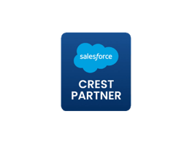
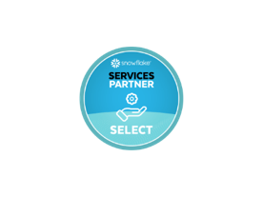

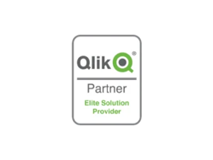












Partnerships & Certificates
At twoday, our partnerships and certifications reflect our dedication to quality and expertise. By working with industry leaders and maintaining trusted credentials, we ensure our solutions are reliable, secure, and built to meet your unique challenges.
Other
With experts all around the Nordics, we make sure you reach your goals.
Microsoft
Partnering with us means partnering with one of the leading Microsoft Solutions Partners.
Salesforce Partner Crest Status
Snowflake Elite Partner
LS Retail - Diamond Partner
Qlik - Elite Solution provider
Databricks
TimeXtender Heart Partner
UiPath Authorized Business Partner
Pigment Consulting Regional Partner
Anaplan Delivery Partner – Finance

Slide 13




Most impactful partner for data-intense and design-led digital engineering
Energy & utilities
“Reduce emissions from overproduction by 30% with AI-driven forecasting and grid optimization”
Digital strategy based on industry expertise
Industrials & manufacturing
“Reduce forecasting errors by 40% with AI forecasting solutions and utilization optimization”
Design
Data & AI
Health & Life Sciences
“Predict hospital bed and doctor shortage, reducing patient waiting time by 40% and overtime cost by 30%”
Software Engineering
Cloud Platform & Security
Government
“AI-driven public tax and welfare fraud detection, reducing public overpayment by 25% to 30%”
Industry and technology accelerators

Slide 14





Industry impact of global megatrends
The rise of AI
Green transition
Ageing population
Digital-first world
Geopolitical shifts
Energy &
Utilities
Industrials &
Manufacturing
Health &
Life Sciences
Government

Slide 15

Industries

Slide 16




Solving industry challenges with technology
Energy & Utilities
Industrials & Manufacturing
Health &
Life Sciences
Government

Slide 17





Energy & Utilities
Industries
The energy and utility sector is at a pivotal stage with the transition to renewable energy, increasing electricity consumption, and growing consumer expectations.
This calls for innovative and secure energy and utilities software solutions and with our in-depth industrial expertise, twoday can help you become a market leader.
Accelerate the energy transition
Tailored digital solutions for Energy & Utilities
Industry expertise
Drive data-driven decisions
Improve sustainability reporting
Scalable and secure solutions

Slide 18





Industrials & Manufacturing
Industries
Industrial companies are experiencing big needs for business transformation due to globalization and tougher competition.
New technology, including industrial manufacturing software,
is providing great opportunities to tackle these challenges on many fronts.
We are ready to help you on the journey towards future success.
Prevent downtime with real-time production monitoring
Enhance efficiency with smart system integration
Optimize operations with AI & IoT
Leverage scalable and secure IT solutions
Protect your production with cybersecurity for IT & OT
Stay compliant with automated documentation and traceability

Slide 19




Health & Life Sciences
Industries
The healthcare sector is undergoing extensive digitalization. Robots, AI-based diagnoses, and digital consultations are gaining ground everywhere.
twoday is a key supplier of custom healthcare software solutions to the healthcare sector and has extensive experience in delivering comprehensive and secure healthcare software solutions for citizens and professionals in both public and private healthcare.
Utilization of data and AI
Telemedicine
Health apps
Expertise within health & life sciences
Scalable and secure solutions
Tailored digital solutions

Slide 20






Government
Industries
Helping public organizations modernize their IT
Governments are under pressure to provide efficient, secure, and accessible digital services while meeting regulatory demands and budget constraints. For years, twoday has been a trusted IT partner for the Nordic public sector, helping organizations streamline operations, improve citizen services, and strengthen security with modern, scalable solutions.
We support public organizations by:
Improving citizen services with intuitive, user-friendly digital platforms.
Increasing efficiency through automation and better data management.
Ensuring security and compliance with reliable cloud and cybersecurity solutions.
Supporting informed decision-making with secure, data-driven insights.
With expertise in software development, standard business applications, cloud solutions, and data and AI, twoday helps governments modernize their IT infrastructure—creating better services, improving resilience, and building public trust
Notes:
Helping public organizations modernize their IT
Governments are under pressure to provide efficient, secure, and accessible digital services while meeting regulatory demands and budget constraints. For years, twoday has been a trusted IT partner for the Nordic public sector, helping organizations streamline operations, improve citizen services, and strengthen security with modern, scalable solutions.
We support public organizations by:
Improving citizen services with intuitive, user-friendly digital platforms.
Increasing efficiency through automation and better data management.
Ensuring security and compliance with reliable cloud and cybersecurity solutions.
Supporting informed decision-making with secure, data-driven insights.
With expertise in software development, standard business applications, cloud solutions, and data and AI, twoday helps governments modernize their IT infrastructure—creating better services, improving resilience, and building public trust

Slide 21

Our services

Slide 22





Uniting global reach and local strengths
Data & AI
Software
Engineering
Cloud Platform
& Security
Digital
Experience
Business Applications

Slide 23

Data & AI
Services
We specialize in harnessing the power of data and artificial intelligence (AI) to drive businesses forward. Our data and AI services are designed to empower organizations by delivering solutions that enhance decision-making and fuel business outcomes.
Data strategy
BI & analytics
Data platforms
Corporate performance management
Process development & automation
AI
IoT

Slide 24



Transforming tomorrow through Data & AI
At twoday we specialize in harnessing the power of data and artificial intelligence (AI) to drive businesses forward. Our data and AI services are designed to empower organizations with solutions that enhance decision-making and fuel business outcomes.
AI Strategy
Our AI Program supports all phases from ideation, use case assessment to user adoption and IT operations.
Custom AI
When it is necessary to move beyond off-the-shelf AI solutions, our expert AI consultants deliver Tailored AI Solutions to your business needs.
Embedded AI
Our ability to deliver Embedded AI Solutions makes it possible to integrate AI capabilities directly into hardware devices or software.
Productized AI
We have a proven track record of use case implementations with ready to deploy Productized AI Solutions which are cost-effective and easy to integrate.
300+ AI Use Cases
in production​
for 200+ Customers
in private & public sectors
by 110+ AI experts
working on various advanced use cases
in large Nordic companies​​

Slide 25

Software Engineering
Services
We drive digital transformation through custom software development, leveraging cloud services and application expertise. We utilize the latest technology, to develop high-quality and scalable software solutions following industry best practices.
Digital transformation
Software development
Application services
Consulting

Slide 26

Cloud Platform & Security
Services
We help you by visualizing threats to compliance, security and performance in IT infrastructure, and prioritize tasks and resources accordingly.
Our specialists are recognized as leaders in the fields of Azure management and governance, enterprise endpoint management and security, and infrastructure visualization.
Cloud and Data Center
Endpoint Management
M365 CoPilot
Security and Identity

Slide 27

Digital Experience
Services
We turn ideas into top-notch digital experiences. Whether it's designing user-friendly websites, setting up seamless eCommerce solutions, or crafting modern workspaces, we've got you covered.
Design & UX
Websites
eCommerce
Intranets
Apps

Slide 28

Business Applications
Services
Looking to elevate your business operations? Partner with us to implement business applications that not only reduce costs but also increase efficiency. With our solutions for finance, ressource planning, sales, marketing, customer service, and more, we're dedicated to your success.
ERP
Customer Engagement
CRM
Low code & no code solutions
Process optimization and workflow automation
Business Intelligence & Analytics

Slide 29

Why customers choose twoday
Deep industry expertise and knowledge
Strong partnerships and long-term client relationships
Proven track record of delivering complex digital solutions
Flexible, adaptive teams with high technical competence
A culture built on drive, heart, and adaptability
Local presence with a commitment to Nordic values
“Working with twoday to get the system up and running, and subsequently create value, has been a practicable process. twoday have been a flexible and conscientious partner, and easy to work with.”
Michael Hejlskov Jacobsen, Grundfos

Slide 30
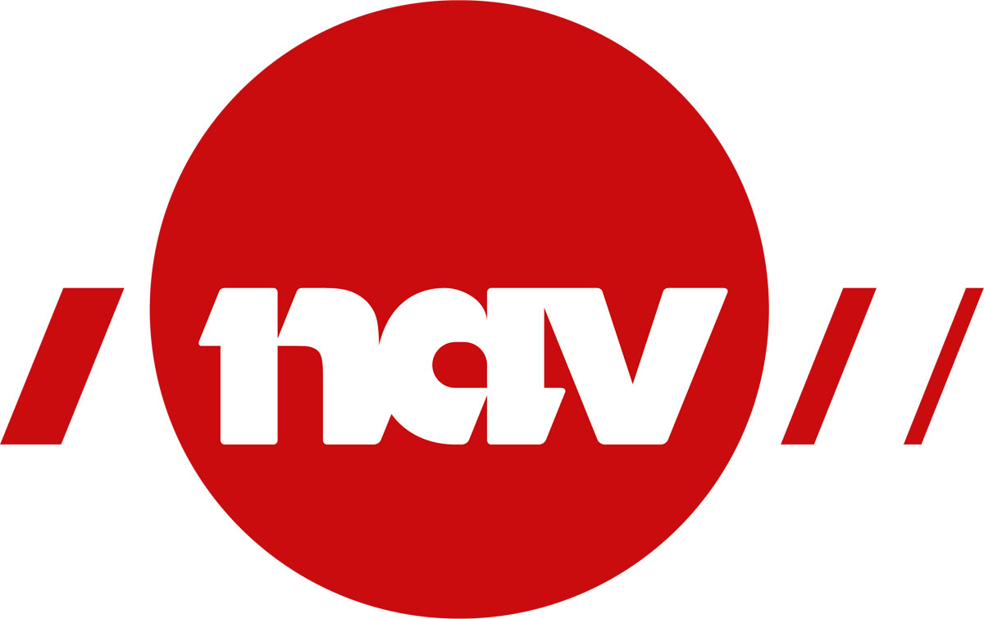

The Norwegian Directorate of Labour and Welfare
Customer Stories
Synthetic data
CHALLENGES
NAV - The Norwegian Labour and Welfare Directorate needed to test their IT systems using as few production data as possible. NAV wanted to populate its TPS system (NAV's version of the population register) with synthetic data.
THE SOLUTION
NAV has obtained a faster process that makes it possible to generate up to 10,000 synthetic persons in a few minutes. The data is secured and impossible to trace back to physical persons.
RESULTS
NAV has obtained a solution divided into three basic solutions for synthetic data:
Mini-Norway: A basic population that is available and "alive" in synthetic environments.
Dolly: A self-service solution that democratizes how NAV creates synthetic data.
Orchestrator component: An application for managing synthetic data, controlling fictitious persons and their personal information.
Notes:
Case example

Slide 31
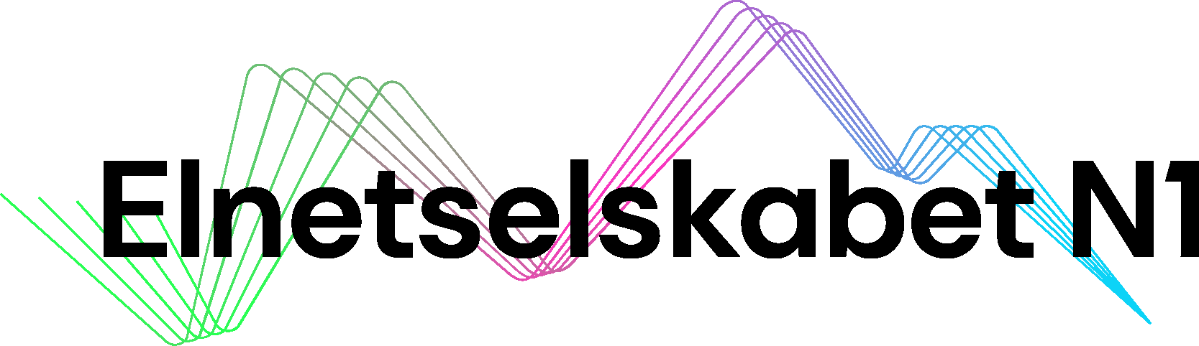
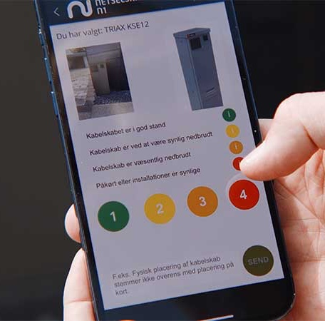
Elnetselskabet N1
Customer Stories
N1GO! app makes collecting data a breeze
THE CHALLENGE
What do you do if you are missing data on 220,000 cable cabinets? N1 knew where all their cabinets were located, but they did not know the condition or type of the cabinets.​
THE SOLUTION
Was a Pokémon GO-like app, called N1GO!, where employees collect data on cable cabinets in their local area. In four months, N1 has collected approximately 145,000 marked cabinets, or the equivalent of approx. 14 years overview.​
HOW?
Using an image recognition algorithm, users can uncover and assess the type and condition of N1's cable cabinets through the app.
Notes:
Case example

Slide 32


GN Store Nord
Customer Stories
Monitoring product feedback
WHAT
Build an ML system that classify customer reviews into service and product categories and assess sentiment
WHY
Efficiently collect and analyse customer reviews for new products to identify quality issues and minimize manual labour.
Initially designed for English text, with the capability to expand to other languages in the future.
HOW
Machine learning cloud system that automatically
Predicts topics involved in each sentence in reviews
Predict the sentiment related to topic
Confidence evaluate ML model performance
Ability to retrain models and monitor drift over time
Notes:
Case example

Slide 33


UPM
Customer Stories
Collaboration began in 2020, focusing on data platforms & data governance
CUSTOMER OBJECTIVE
Making data easy for business
Empowered business units to use data more efficiently.
Brought data development closer to business areas, ensuring early and frequent value delivery.
Introduced a common platform and a resilient way of working, driving automation and reducing costs.
ONGOING IMPACT
Supported multiple business units in becoming more data-driven and leveraging common tools effectively.
NEXT STEPS
Exploring AI integration to maximize the value of existing data assets.
RESULTS
Implemented modern tools like Aecorsoft, Snowflake, and dbt to streamline large-scale data operations.
Replaced outdated methods, enabling faster delivery of new use cases and quicker time to value.
Fostered organization-wide data ownership, with data treated as a product.

Slide 34




Contact
Jane Doe
janedoe@twoday.com
+47 987 65 432
twoday.com
Notes:
Heart
Our business is run with heart.
We care about people, our customers and society. We are a warm community filled with people that have fun and laugh together.
We welcome people as they are, we team up and thrive together.
Drive
To succeed in the digital transformation of our society we need people with initiative, dedication and engagement.
People that continuously develop themselves and learn new things is the key to deliver the competence that is needed in the digital age.
Our drive and ambition moves society forward.
Adaptability
Technology is constantly changing and so are the needs of people and organizations.
We are adaptable in our approach, down to earth and easy to work with.
We trust in people and believe that we do our best with a good balance of freedom and responsibility.

